Slide 1
Dramatic Visualizations
Notes:
Thanks for that introduction Alex.
I hope Alex has convinced everyone that you should at lease be dabbling in infographics and visual communication. And he’s right.
But I want to talk about an element of infographics that is underappreciated… the dramatic element. If we’re fitting our data into a story, we need to make that story as compelling as possible. And we can do that by applying very traditional dramatic elements to our visualization.

Slide 2
Notes:
Thanks for that introduction Alex.
I hope Alex has convinced everyone that you should at lease be dabbling in infographics and visual communication. And he’s right.
But I want to talk about an element of infographics that is underappreciated… the dramatic element. If we’re fitting our data into a story, we need to make that story as compelling as possible. And we can do that by applying very traditional dramatic elements to our visualization.

Slide 3
Notes:
Thanks for that introduction Alex.
I hope Alex has convinced everyone that you should at lease be dabbling in infographics and visual communication. And he’s right.
But I want to talk about an element of infographics that is underappreciated… the dramatic element. If we’re fitting our data into a story, we need to make that story as compelling as possible. And we can do that by applying very traditional dramatic elements to our visualization.
It is important to remember that this data lives inside a context, inside a story. And if we understand that it is a story, we can improve the impact by scripting that story intelligently, keeping in mind some key dramatic elements.

Slide 4
establish rhythm contrast expectations
Notes:
I’m going to talk about 4 dramatic elements here, establishment of the story, using rhythm as we advance the story, contrasting elements and finally playing off the audience expectations.
We can actually bring any dramatic elements into a visualization because, at the core, the visualization IS a small scale drama. But time is limited so I’m only going to mention these four. And I’m going to use my most recent visualization as an example.
I’m going to illustrate these elements using my latest video.

Slide 5
[show 2012 National Debt Road Trip video]

Slide 6
establish rhythm contrast expectations
Notes:
First, we’ll talk about establishing a context

Slide 7
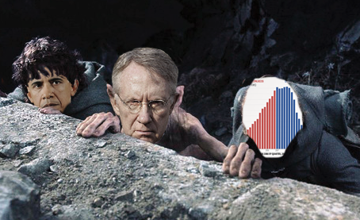
establish
data lives inside a context
Notes:
More often than not, we will need to establish a certain baseline context for the story our data lives in. Now, this image is a little misleading because if we’re looking at this from a narrative perspective, the data is less of a character in the story and more of the terrain the characters traverse or an obstacle they might encounter. The story is in the characters and how they deal with that data, that obstacle.

Slide 8
Notes:
In most cases not everyone knows what that story is. We may need to introduce the important characters, explain the context in which they live and their motivations and goals so we can see the conflict that arises when our characters meet the data. In essence, we need to establish our story line.
In my blog posts, I do with this with 1) an few short sentences of introduction and 2) a title that gives the topic of the infographic. In my videos, I have less control so I spend a good 20-30 second establishing a solid context around the data we’ll be investigating.
This context creates a frame of mind for the audience, and gets them “into the zone” that you want them in for understanding the data.

Slide 9
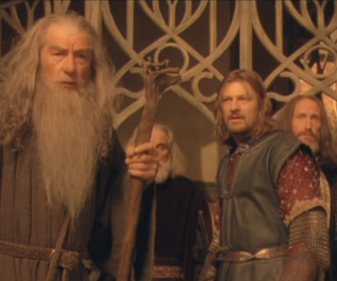
Notes:
In most cases not everyone knows what that story is. We may need to introduce the important characters, explain the context in which they live and their motivations and goals so we can see the conflict that arises when our characters meet the data. In essence, we need to establish our story line.
In my blog posts, I do with this with 1) an few short sentences of introduction and 2) a title that gives the topic of the infographic. In my videos, I have less control so I spend a good 20-30 second establishing a solid context around the data we’ll be investigating.
This context creates a frame of mind for the audience, and gets them “into the zone” that you want them in for understanding the data.

Slide 10
Notes:
In most cases not everyone knows what that story is. We may need to introduce the important characters, explain the context in which they live and their motivations and goals so we can see the conflict that arises when our characters meet the data. In essence, we need to establish our story line.
In my blog posts, I do with this with 1) an few short sentences of introduction and 2) a title that gives the topic of the infographic.
This context creates a frame of mind for the audience, and gets them “into the zone” that you want them in for understanding the data.

Slide 11
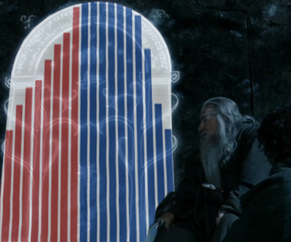
Notes:
In most cases not everyone knows what that story is. We may need to introduce the important characters, explain the context in which they live and their motivations and goals so we can see the conflict that arises when our characters meet the data. In essence, we need to establish our story line.
In my blog posts, I do with this with 1) an few short sentences of introduction and 2) a title that gives the topic of the infographic.
This context creates a frame of mind for the audience, and gets them “into the zone” that you want them in for understanding the data.

Slide 12
establish
Static (blog posts, graphics)
data introduction
good data-centric title
Notes:
In my blog posts, I do with this with 1) an introduction and 2) a title that gives the topic of the infographic.
In my videos, I have less control so I spend a good 20-30 second establishing a solid context around the data we’ll be investigating.

Slide 13
establish
Static (blog posts, graphics)
data introduction
good data-centric title
Dynamic (videos)
20-30 second introduction
Notes:
In my blog posts, I do with this with 1) an introduction and 2) a title that gives the topic of the infographic.
In my videos, I have less control so I spend a good 20-30 second establishing a solid context around the data we’ll be investigating.

Slide 14
establish
Rick Perry and Texas Job Numbers
Notes:
What does story establishment look like in the real world. Let’s take this example from when Rick Perry was running for president (you people always want what you can’t have), there was a lot of liberal noise about how his job numbers weren’t *really* that awesome. I looked into the data and I won’t bore you with all the details, but here’s the introduction I gave:
“I knew Utah had a lower unemployment rate than Texas and I kept hearing Texas was so great at jobs, blah, blah, blah, blah so I looked up the unemployment rate.
8.2%. Nothing special.
So I was going to drive my point home that Texas was nothing special by looking at their raw employment numbers and reporting on those. That's when I saw this:

Slide 15
establish
Rick Perry and Texas Job Numbers
“I knew Utah had a lower unemployment rate than Texas and I kept hearing Texas was so great at jobs, blah, blah, blah, blah so I looked up the unemployment rate.
8.2%. Nothing special.
So I was going to drive my point home that Texas was nothing special by looking at their raw employment numbers and reporting on those.”
Notes:
For example, when Rick Perry was running for president (you people always want what you can’t have), there was a lot of liberal noise about how his job numbers weren’t really that awesome. I looked into the data and I won’t bore you with all the details, but here’s the introduction I gave:
“I knew Utah had a lower unemployment rate than Texas and I kept hearing Texas was so great at jobs, blah, blah, blah, blah so I looked up the unemployment rate.
8.2%. Nothing special.
So I was going to drive my point home that Texas was nothing special by looking at their raw employment numbers and reporting on those. That's when I saw this:

Slide 16
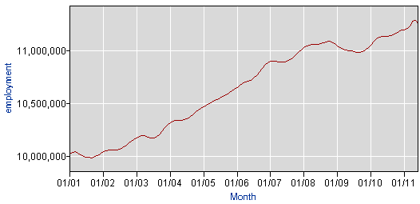
establish
Rick Perry and Texas Job Numbers
Notes:
This may not look like anything special, but I've been looking closely at employment data for a couple years now and I've become very accustomed to seeing data that looks like this.

Slide 17
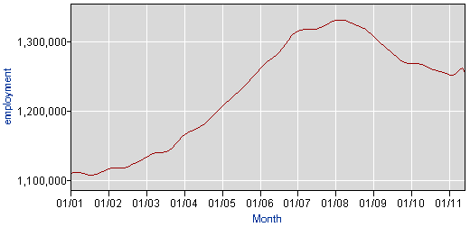
establish
Rick Perry and Texas Job Numbers
Notes:
This may not look like anything special, but I've been looking closely at employment data for a couple years now and I've become very accustomed to seeing data that looks like this.
In a "normal" employment data set, we can easily look at it and say "Yep, that's where the recession happened. Sucks to be us."

Slide 18
establish
Rick Perry and Texas Job Numbers
Texas Jobs
Everyone Else
Notes:
But not with Texas. With Texas, we say "Damn. Looks like they've recovered already."

Slide 19
establish
Rick Perry and Texas Job Numbers
Characters
People touting TX jobs record
Me (the doubter)
Notes:
So we’re 8 sentences in and we’ve established a set of conflicting characters, a baseline of assumptions, and only two charts. We’ve set up a little drama between people touting the Texas jobs record and the doubters like myself.

Slide 20
establish
Rick Perry and Texas Job Numbers
Characters
People touting TX jobs record
Me (the doubter)
Story
Utah jobs are good, right?
“I’ll bet TX jobs aren’t really that great”
Notes:
I also created a little drama about how I became a “true believer” so to speak. I give an introduction to my personal thoughts and presumptions.

Slide 21
establish
the importance of recognition
Notes:
But most importantly, I’ve made a connection with the audience. When they see the story in this scenario, they see a part of themselves, albeit far more attractive. We all know some snippets of data, that we never really bothered to look up. We’re all familiar with having that general feeling that the world is such-and-such a way only to be surprised when we research it and discover we were wrong about important details.
It is important in the establishment phase of a visualization to make sure your story is something the viewer recognizes. You want the viewer to look through the visualization and say “Yeah, I’ve had that exact conversations” or “I’ve asked those exact questions”. You want them to become one of the characters in the drama.

Slide 22
establish
the importance of recognition
“some will say…”
Notes:
In video form, I usually revert to a kind of “some will say” format where I recap the opposing argument as closely as I can. I also set it up so that I’m tweaking the question in a way that effectively sets up whatever metaphor I’m going to be using in the video.

Slide 23
establish
the importance of recognition
“Texas has an 8.2% unemployment rate. That’s not very good.”
“Texas has lots of jobs, but they’re mostly low-paying”
“Texas is oil country and the energy boom is responsible for the jobs”
“Texas has 100K public sector growth that inflates the job numbers”
Notes:
In the blog post, each time I looked at another set of data, I titled it with the objections that I heard on Twitter. I captured these objections as I heard them so that people would instantly recognize the argument.

Slide 24
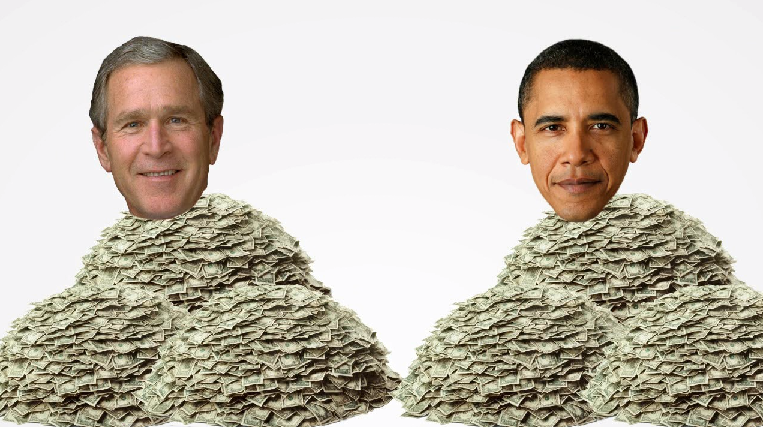
establish
Notes:
In my video, I set up the problem, discuss why an update to my old video is necessary and establish the computational ground rules

Slide 25
establish
Notes:
In my video, I set up the problem, discuss why an update to my old video is necessary and establish the computational ground rules

Slide 26
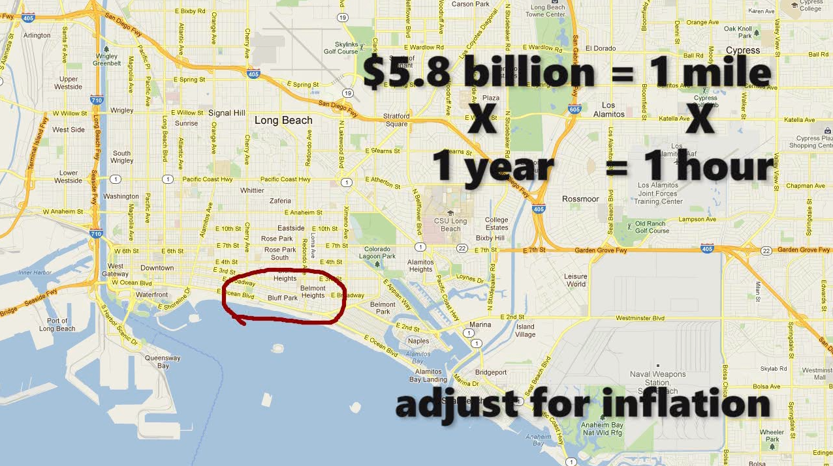
establish
Notes:
In my video, I set up the problem, discuss why an update to my old video is necessary and establish the computational ground rules. The details of these ground rules are ultimately completely irrelevant. There is absolutely nothing important about using $5.8 billion as my calculation for a mile as opposed to $3 billion or $7 billion. What is important is that we explain to the audience that we’re using miles per hour as a proxy to understand debt increases per year. Once we get them on board with that translation, they can forget about the details.

Slide 27
establish rhythm contrast expectations
Notes:
The next part of dramatic visualizations is using rhythm to help the viewer understand data.
I could introduce the problem, slam the data down and say “Boom! Answer done, sucka” and drop the mic. But when I bypass the drama, I’m only hamstringing the effectiveness of my message.

Slide 28
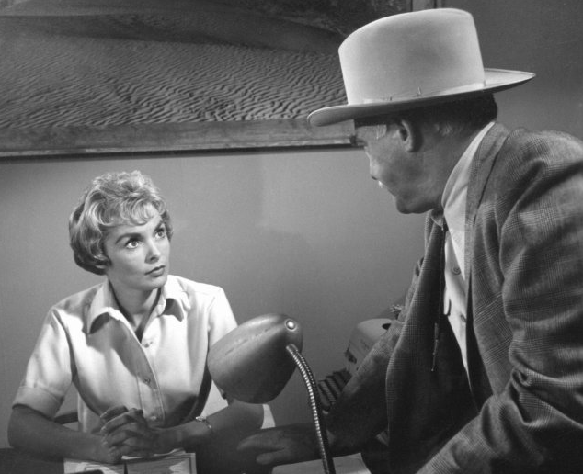
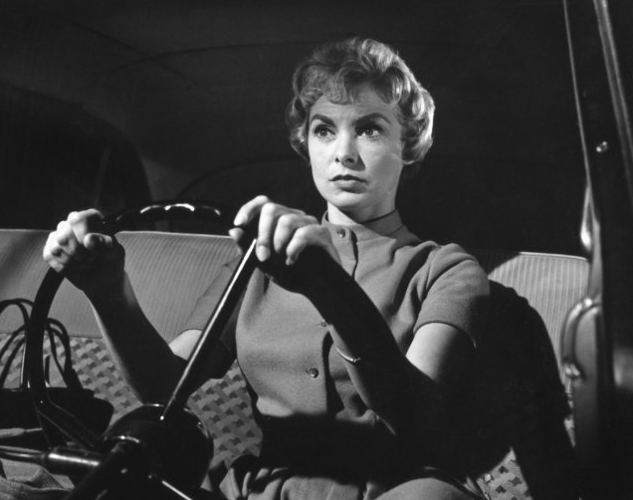
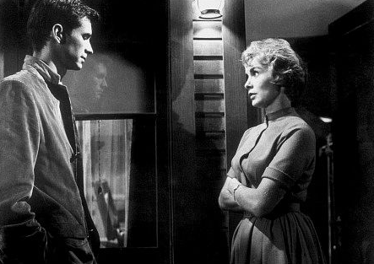
rhythm
Notes:
Think of movies you enjoy, especially thrillers. They take their time getting to “the point”. I could summarize Psycho for you in 30 seconds, but that’s not going to be very engaging and it’s not going to stick with you. The rhythm of the drama, the balance of introduction, exposition, dramatic build up, tension, payoff… these are the things that make the dramatic form so much fun and what makes it stick in our minds
The best visualizations don’t just say “Here’s some data”… they ease the viewer into the data to help them understand what is going on.

Slide 29
rhythm
user-controlled rhythm
(interactive visualizations)
Notes:
(Do the trillion dollar one instead) There are a lot of ways this rhythm can work in visualizations. One fun one is using a zoom to help viewers get a feel for truly huge data sets.
(talk about MSFT and how the rhythm of the user zooming helps them get the scope of natural history), pull in my Republicans vs Dems in Congress visualization, talk about movement of user’s eye)
http://flowingdata.com/2012/03/19/visualizing-the-history-of-everything/

Slide 30
rhythm
The History of Everything
http://www.chronozoomproject.org/
Notes:
This is a visualization created by Microsoft Research where the user can navigate the course of history and it’s a great example of big numbers.
http://flowingdata.com/2012/03/19/visualizing-the-history-of-everything/

Slide 31
rhythm
The History of Everything
Notes:
I’m actually going backward here because I think it’s more effective. We start out with a timeline that covers most of my life span.
There’s a year scale at the top that is hard to see here, but you can see it on the website. We can zoom out to see presidents back to Gerald Ford. The we can zoom out a little further to see a history of the United States, get a feeling of how old the country is compared to recent times.
We continue to zoom out and we see how small US history is in the scope of recorded human history. This block goes back to the ancient Egyptians.
We can keep zooming out until recorded history disappears in the scale of human evolutionary history.
We keep zooming out and the biological traces of human history disappear in the scale of recent biological life on Earth.
(talk about MSFT and how the rhythm of the user zooming helps them get the scope of natural history), pull in my Republicans vs Dems in Congress visualization, talk about movement of user’s eye)
http://flowingdata.com/2012/03/19/visualizing-the-history-of-everything/

Slide 32
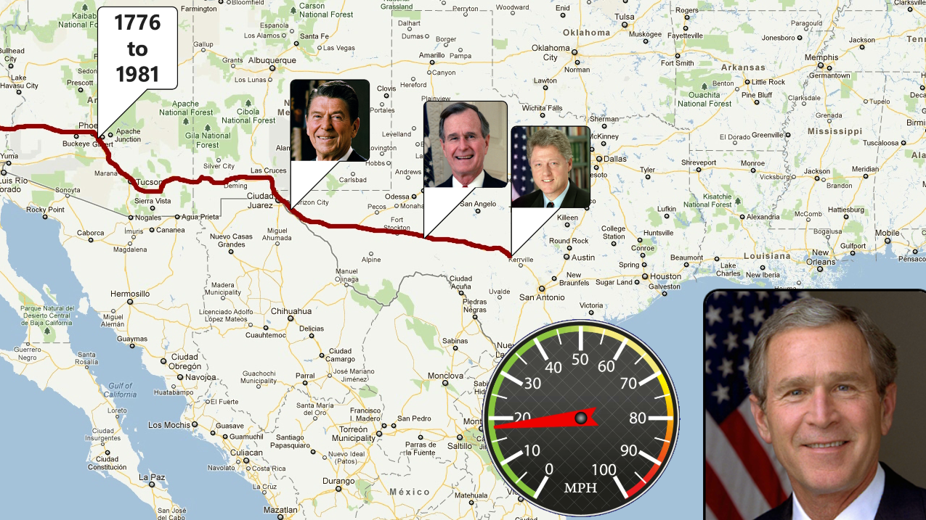
rhythm
Notes:
This is why I spend a chunk of my video setting the stage with 4 previous presidents. Sure, I’m giving important context, establishing what is “normal” in terms of debt increases, but I’m also establishing a rhythm. There once was a man named Ronald Reagan. He was in office for eight years and increased the debt this fast. There once was a man named Bush, he was in office of 4 years, and increased the debt this fast. Etc. The audience can see the pattern and feel like they have a good grip on what is coming next.

Slide 33
establish rhythm contrast expectations
Notes:
Now we get to one of the most important dramatic elements of the visualization process, contrast. Frequently this is the whole point of the visualization… show the difference between thing A and thing B. Virtually every infographic that people are going to remember creates a stark contrast and this contrast is what sticks in their minds.

Slide 34
contrast
Notes:
Contrast is so common in drama, it was hard to chose the best movie example. Do you go with Batman and Joker? Hannible Lector and Clarice Starling?

Slide 35
contrast
Notes:
Contrast is so common in drama, it was hard to chose the best movie example. Do you go with Batman and Joker? Hannible Lector and Clarice Starling?

Slide 36
contrast
vs
all forms of happiness
Notes:
The Phantom Menace and everything in the world that isn’t wicked, sinful and worthy only to be cast into the flame?

Slide 37
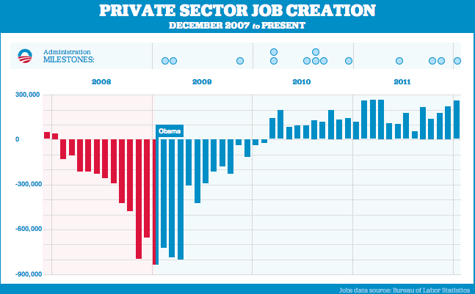
contrast
Notes:
Obama has been using the following graph over the last few years, updating it with every jobs report. The colors point out the contrast he wants us to see, comparing jobs under Bush to jobs during Obama.
I want to take a moment to call out another couple aspects of this chart: We’ve got the contrast part, the eye moves across the page establishing a rhythm year to year, we have characters established (just Bush and Obama in this case) and given that they’ve been using it for two years it is a goddamn tragedy that the GOP doesn’t have a response to this thing.

Slide 38
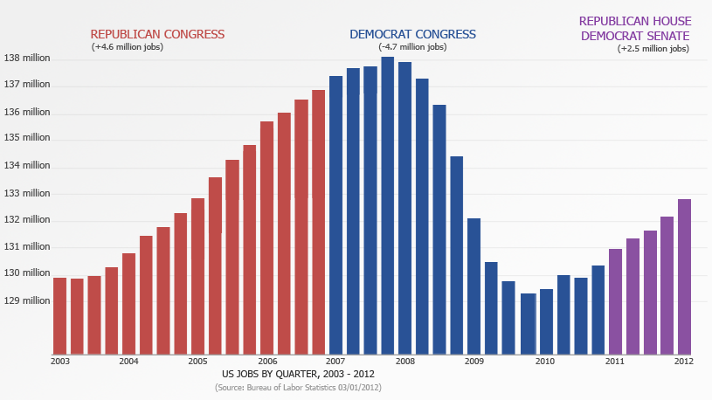
contrast
Notes:
So here’s mine. This is a bit unfair because I’m only counting the House of Representitives. Here’s a slightly less effective one.
Honestly, this is also unfair because it implies that Congress is responsible for jobs. But the real point is that they are as responsible for jobs as the President is. The GOP could play this little “correlation equals causation” game to show Obama’s chart for the sham it is and I am dumbfounded as to why some douchebag talentless designer-programmer wannabe in nowhere Utah is returning the volley instead of the opposing party.
But at least I don’t have any strong opinions about it. Moving along. Contrast.

Slide 39
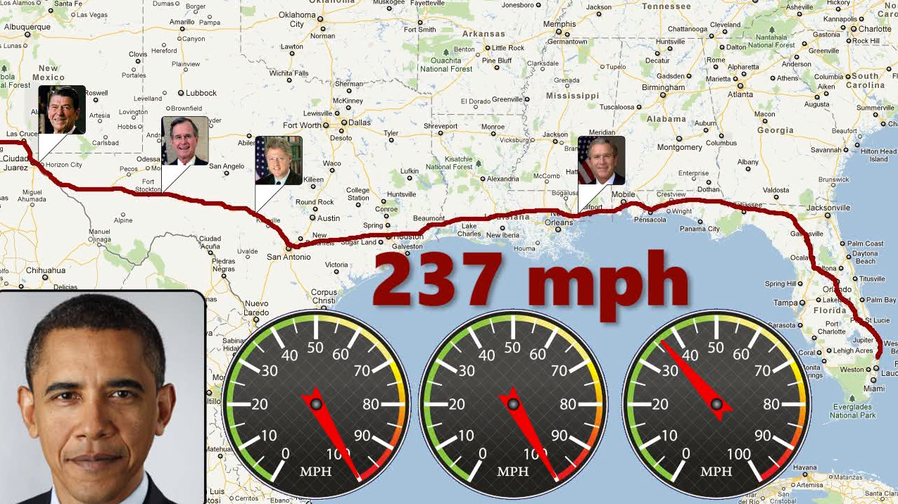
contrast
Notes:
The rhythm I mentioned previously allows the contrast in my video to stand out. I’ve increased the font size and and the text is red instead of black. We’re using 3 odometers instead of 1 (since they max out at 100 miles per hour, which was not an accident). Everything about this has been carefully designed to provide contrast between Obama’s debt record and everything that came before it.

Slide 40
establish rhythm contrast expectations
Notes:
Finally, our last dramatic element is to play off of the audience expectations.

Slide 41
expectations
Usual Suspects

Slide 42
expectations
Notes:
The reason the Usual Suspects and Sixth Sense “worked” so well against audience expectations wasn’t because they had compelling surprises. It was because, before the surprise, they had already met audience expectations. Once the films felt concluded, audiences felt comfortable and let down their guard, expecting a typical epilogue stlye wind-down. Knowing audience expectations allowed the filmmakers to subvert them and that is when the drama really lodged in the minds of the audience.
In summary: Expectations…

Slide 43
expectations
DESTROY THEM
Notes:
Destroy them

Slide 44
expectations
requires understanding of audience and medium
Notes:
The trick to this is that it requires a very good understanding of your audience and what they are going to expect. And it’s very hard to do multiple times because if it becomes part of a schtick, people expect it and then it’s not as unexpected.

Slide 45
Notes:
But a simple example of this is a stupid-ass chart about the Buffett Rule I created in 5 minutes that I thought would be fun. It ended up getting viewed a good number of times, thanks in no small part to AllahPundit who, if he is in the room right now, needs to get the hell back on Twitter. You can see the revenue from the Buffett rule there at the top and in a blog post it looks like the chart just goes off the bottom edge of the screen. The average person would just assume that it’s a shade too long for their browser and they just need to scroll down a tap to see the rest of it. Instead…

Slide 46
Notes:
Instead, that initial scroll to see the edge of the chart clipped off by the reveals that it just keeps going and going. The shock value makes it stick and the audience understands is that the Buffett rule brings in so little revenue that we can’t even effectively visualize it on a normal chart.

Slide 47
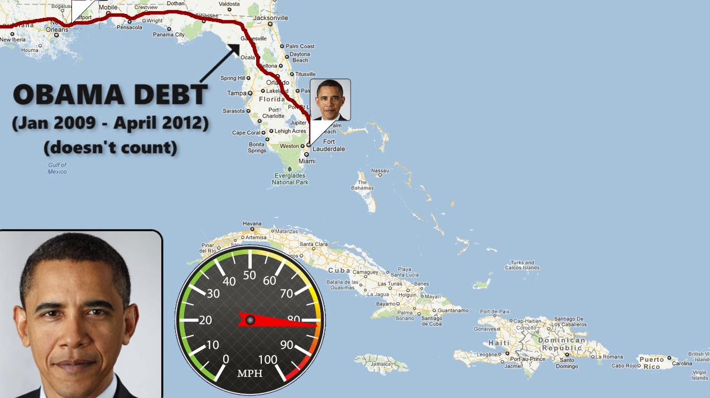
expectations
Notes:
In my video I was tied to the fact that this was an update to a video I made 3 years ago. I couldn’t change too much of the original concept without the risk of looking duplicitous.
I toyed around with a half-dozen different road trip routes to see which ones made the most sense. I wanted to end Obama’s current position close to a shore line so that the audience would think I was done. After all, you can’t take a road trip out into the ocean. But I also didn’t wanted the trip over the ocean to get close to some real destination. I could say “And then we go out into the pacific a third of the way to Hawaii”, but a third? Whoop de do. In terms of how people understand distance, there’s not a huge difference between 1/3 of the way to Hawaii and ½ of the way to Hawaii and 2/3 of the way. I wanted to get specifically to a place.
I tried New York to LA, Seattle to Florida, Seattle to New York, Maine to Florida…

Slide 48
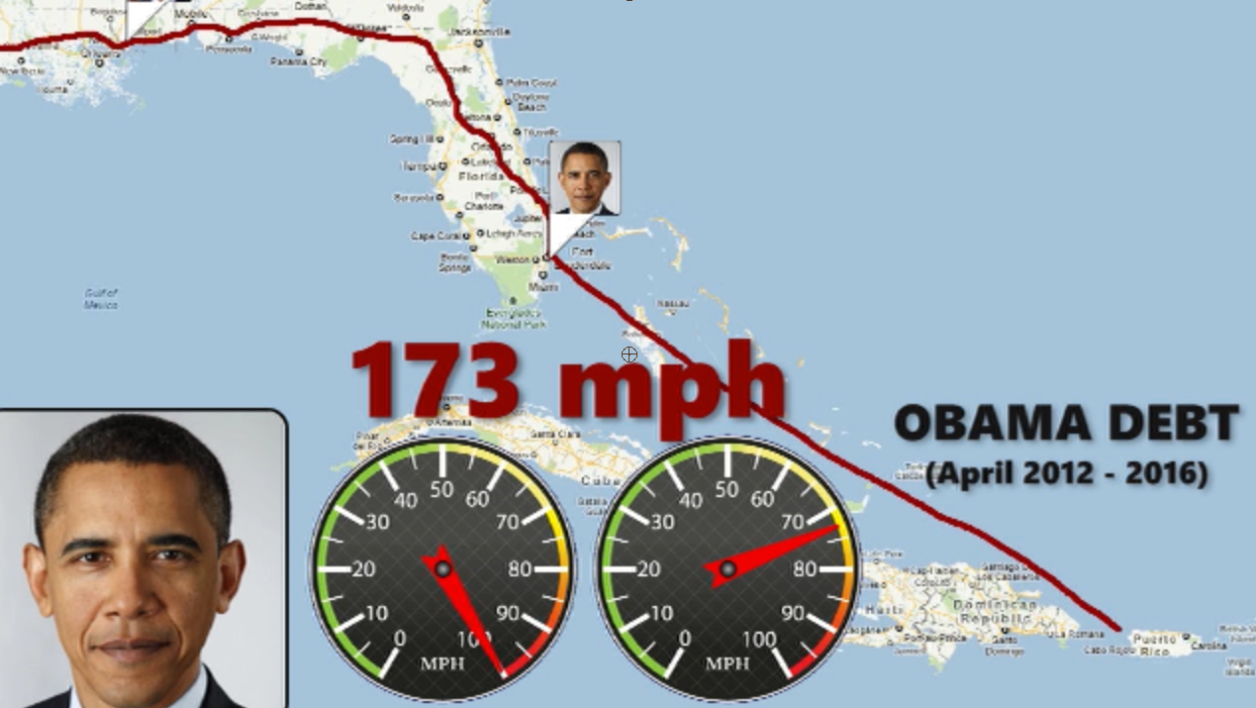
expectations
Notes:
In the end I traveled from just north of Miami to Puerto Rico, which is a nice healthy distance and also allowed me to make a cheap joke at the President’s expense. The shock to the viewer is that we thought we had come to the end but really we’re still just in the middle of shocking debt increases and there is no plan from Obama on the table to even begin to deal with the deficit in a sane manner.

Slide 49
establish rhythm contrast expectations

Slide 50
establish rhythm contrast expectations
Matthias Shapiro
matthias.shapiro@gmail.com
http://politicalmathblog.com
Twitter
@politicalmath
YouTube
youtube.com/10000Pennies

